Slide 1
Soccer Math Wars
Mandar D, Rajessen S, Sundar V, Ben L

Slide 2
Overview
We created a 2D mathematics themed game for Salah, Xander, and Tamara
The game incorporates their ideas in game levels, characters, abilities and much more

Slide 3
The Game Screen

Slide 4
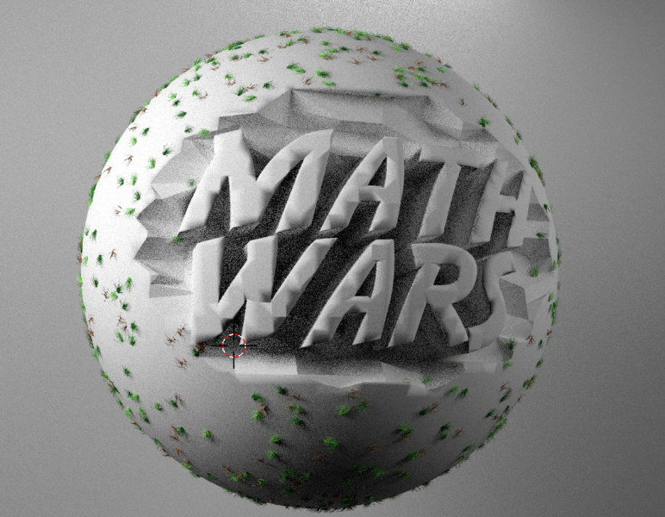
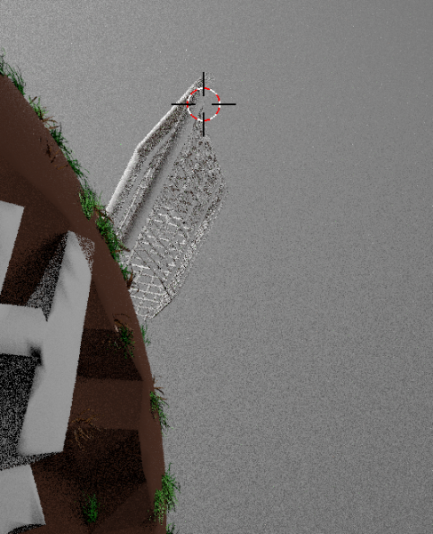
The Making of the Game Title Part 1:
Sphere with Math Wars
Soccer nets and ground terrain

Slide 5
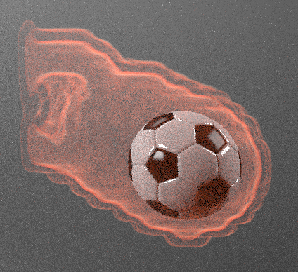
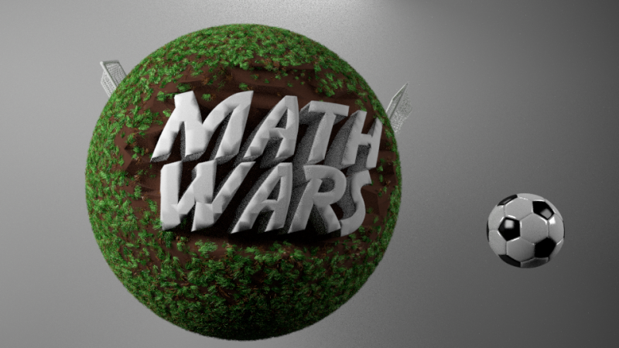
The Making of the Game Title Part 2:
LET'S ADD SOME FLAMES

Slide 6
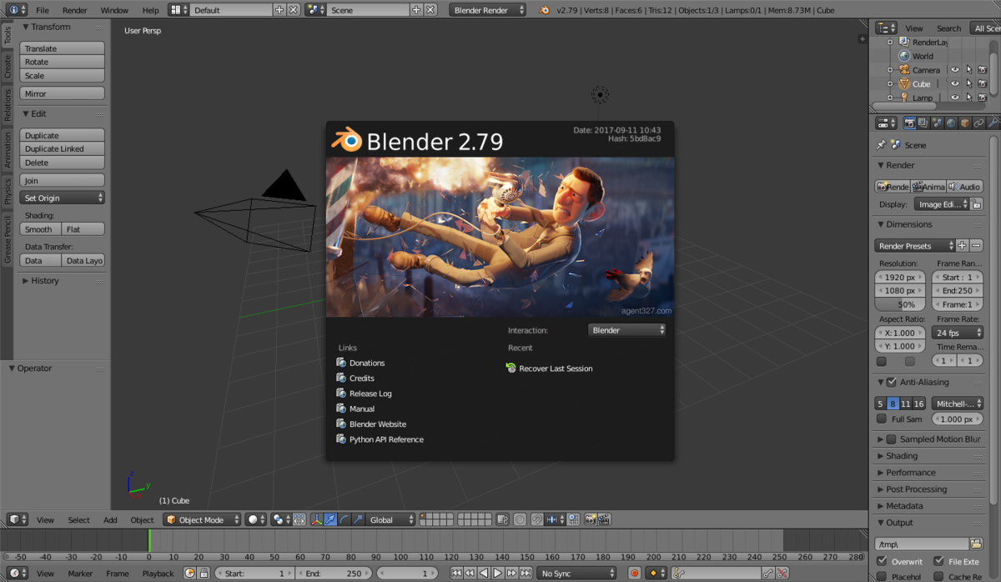

Program Used: BLENDER

Slide 7


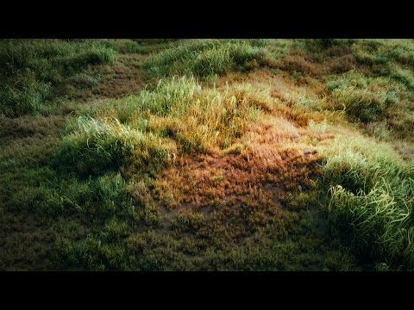
Tutorial Videos Used: (Youtube)

Slide 8
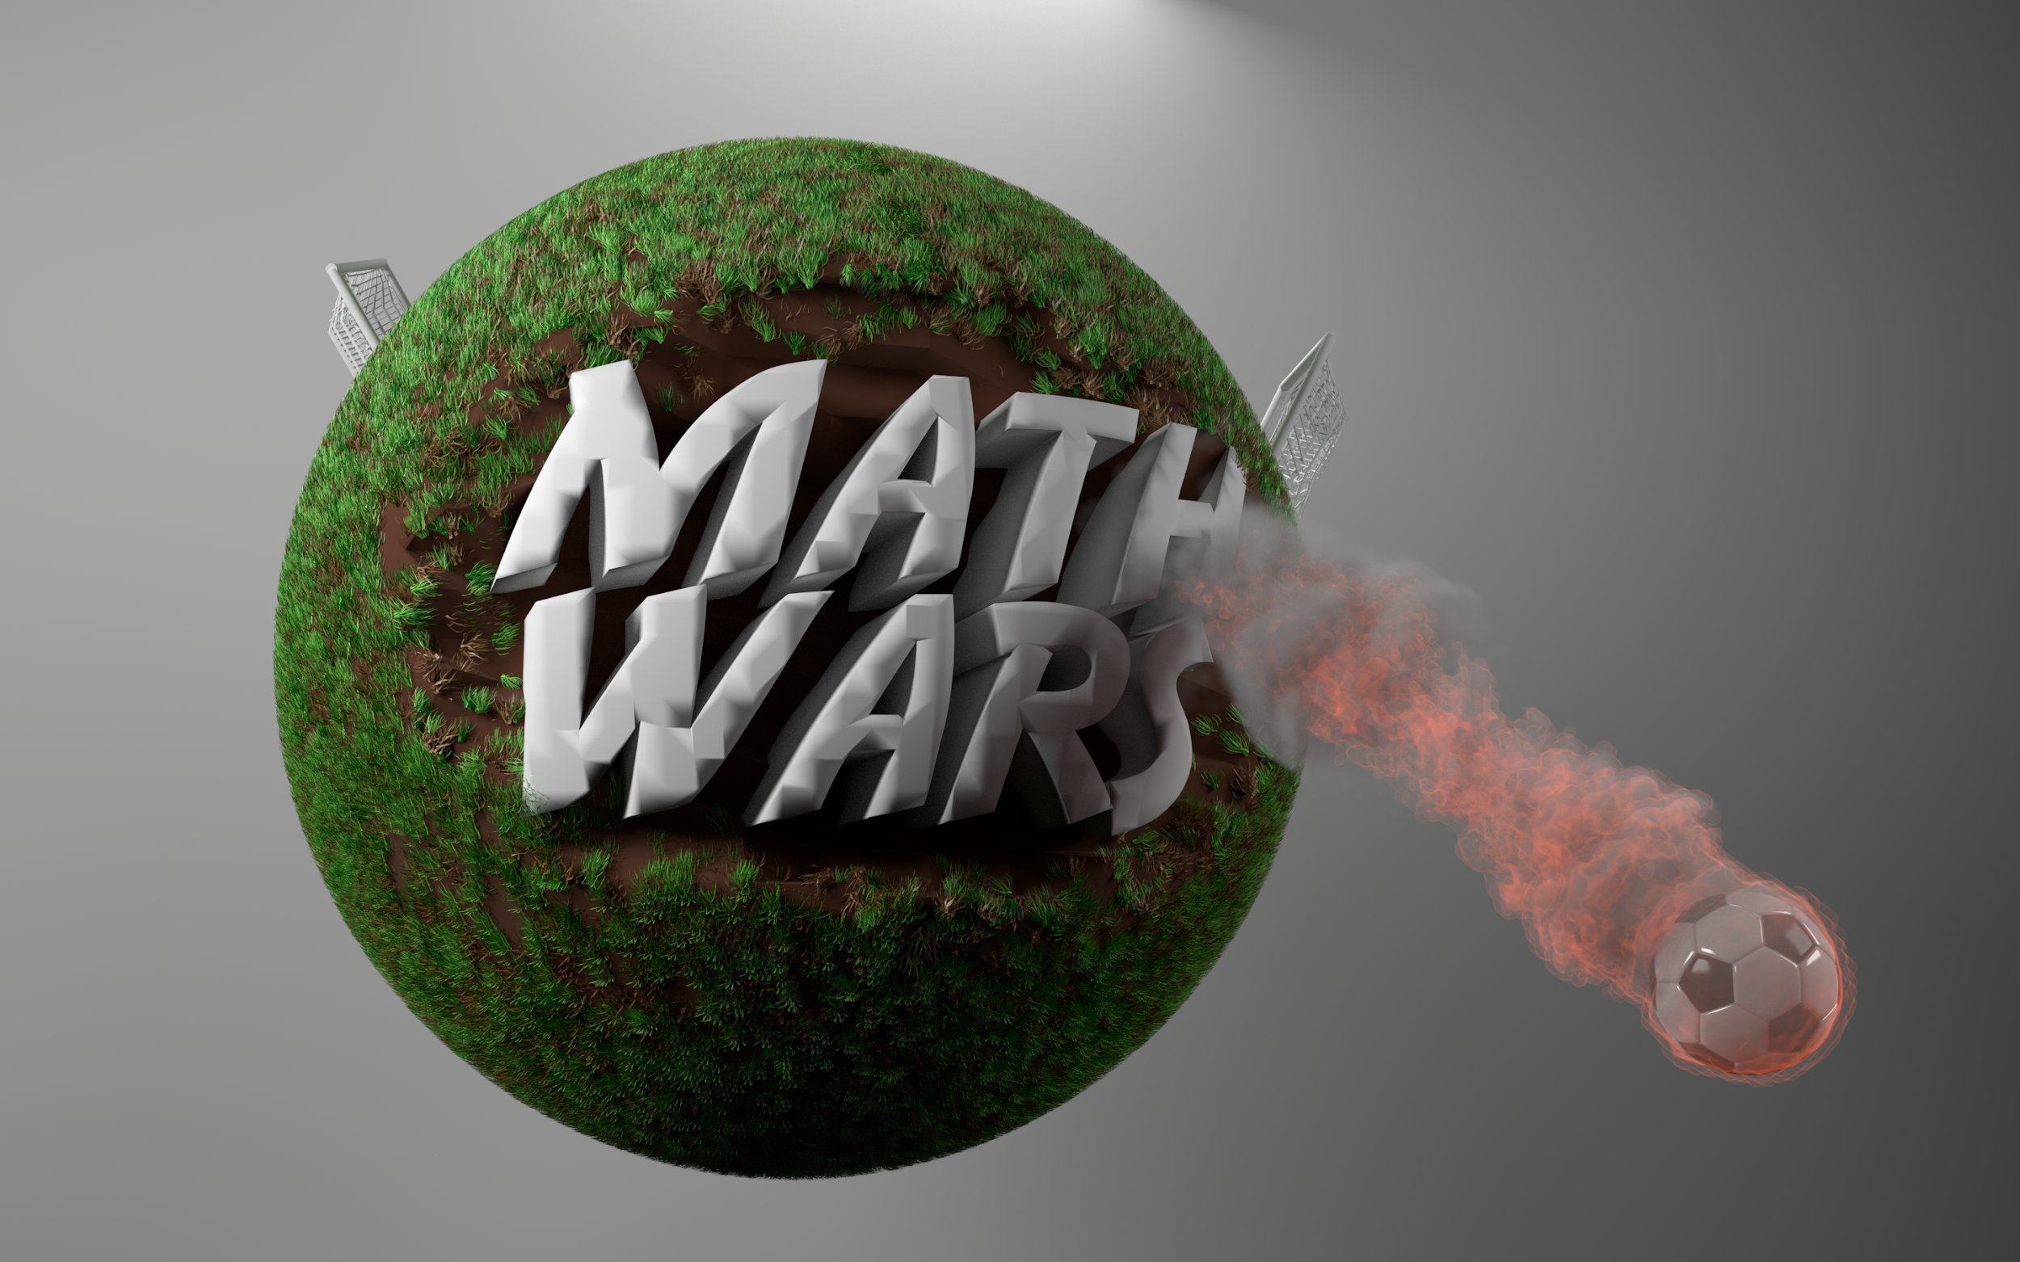
Game Title Screen Final:
Resolution 2880, 1800

Slide 9
How it Works

Slide 10
Basic Game Description
Use key controls to navigate character to other side
Avoid animals coming in from side
If touched by animal,you are asked a math question
When reaching the other side, asked harder math question to shoot into a soccer net
Each question is timed

Slide 11
Storyboard

Slide 12
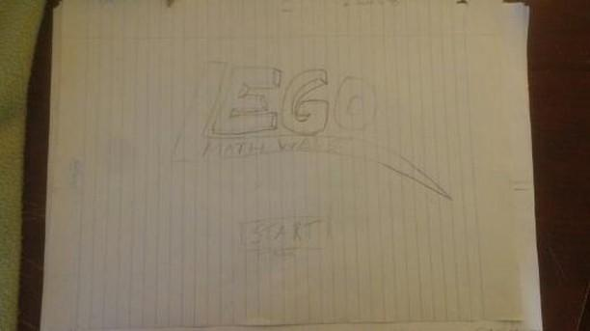
Start with opening graphics

Slide 13
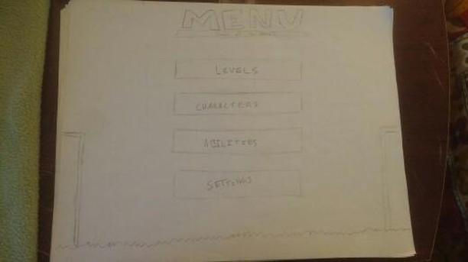
Option menu

Slide 14
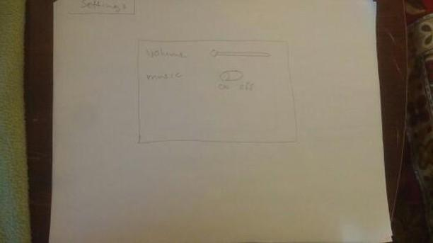
Settings

Slide 15
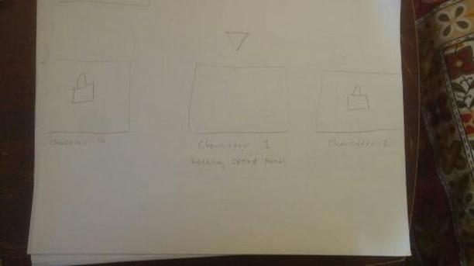
Character Select

Slide 16
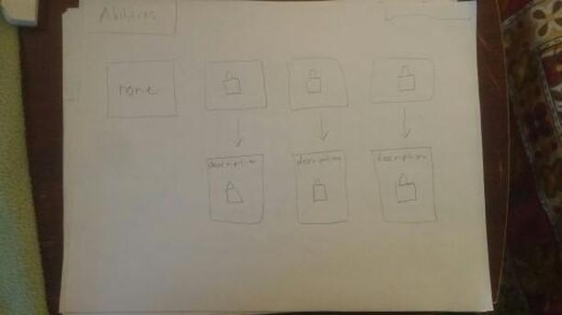
Abilities select

Slide 17
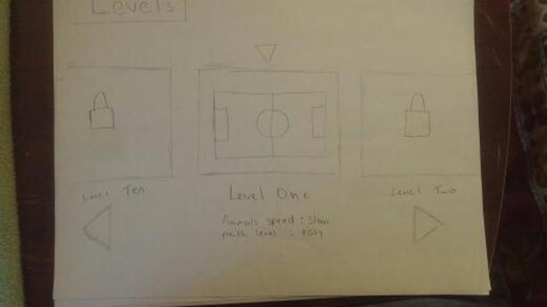
Level Select

Slide 18
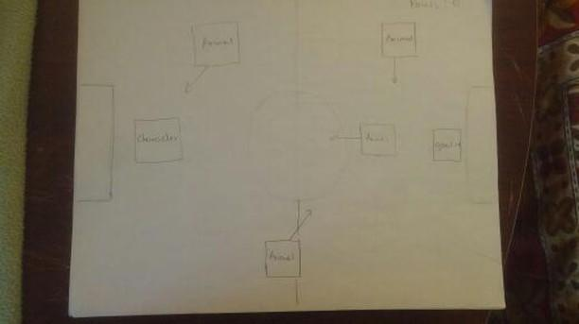
Field example

Slide 19
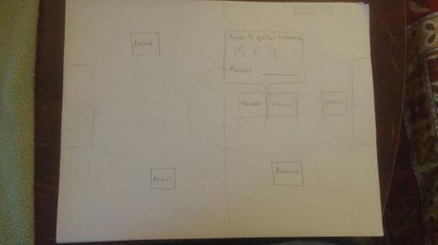
When intercepted by an animal

Slide 20
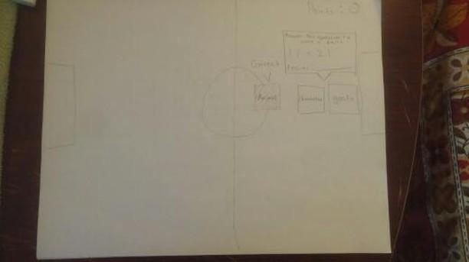
Questions

Slide 21
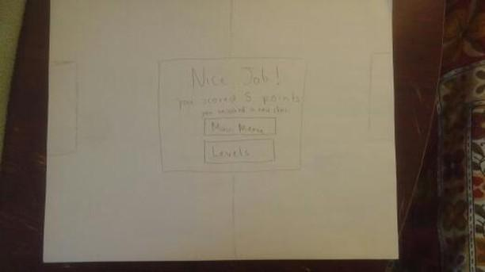
Ending screen

Slide 22
Game Manual

Slide 23
Instructions
Welcome to Soccer Math Wars!
Are you ready to survive the field?
Choose a character and field
Find a way across the field to shoot
Watch out! Try not to be touched by any animal, otherwise you will be put to the test...in Math!

Slide 24
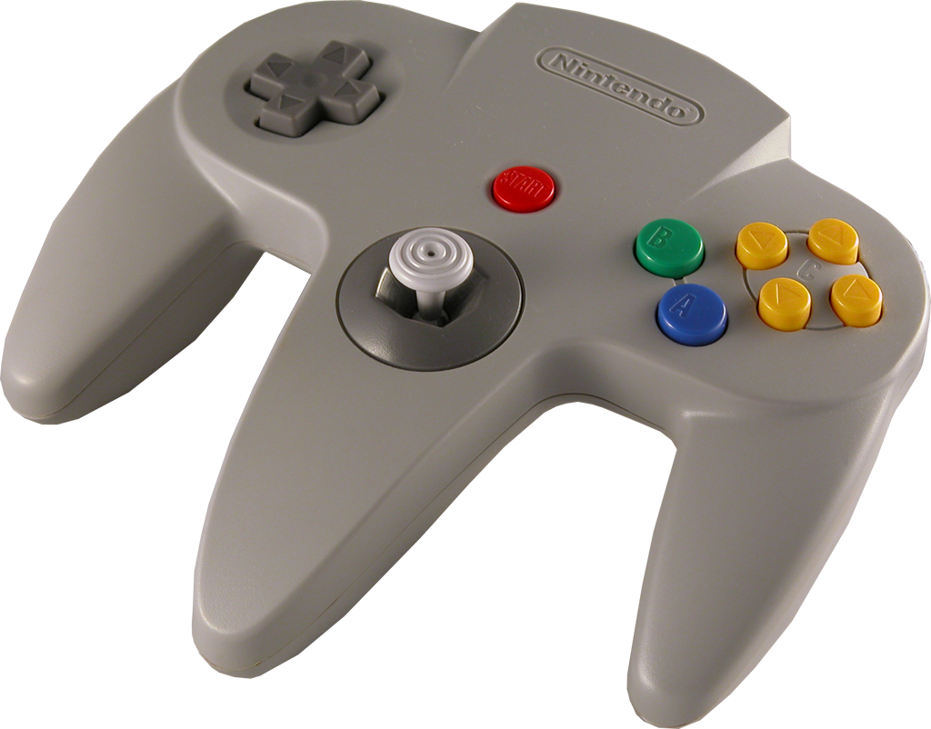
Controls
Arrow keys to move around
Mouse to click question
Number keys to answer
Menu to switch characters and abilities

Slide 25
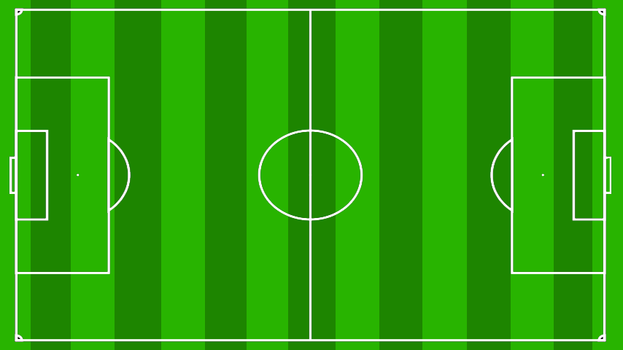
Level/Field Descriptions
Regular Field: 4 animals, addition only
Underwater Field: 4 animals, subtraction only
Volcanic Field: 6-7 animals, subtraction only
Dessert Field: 6-7 animals, addition only

Slide 26
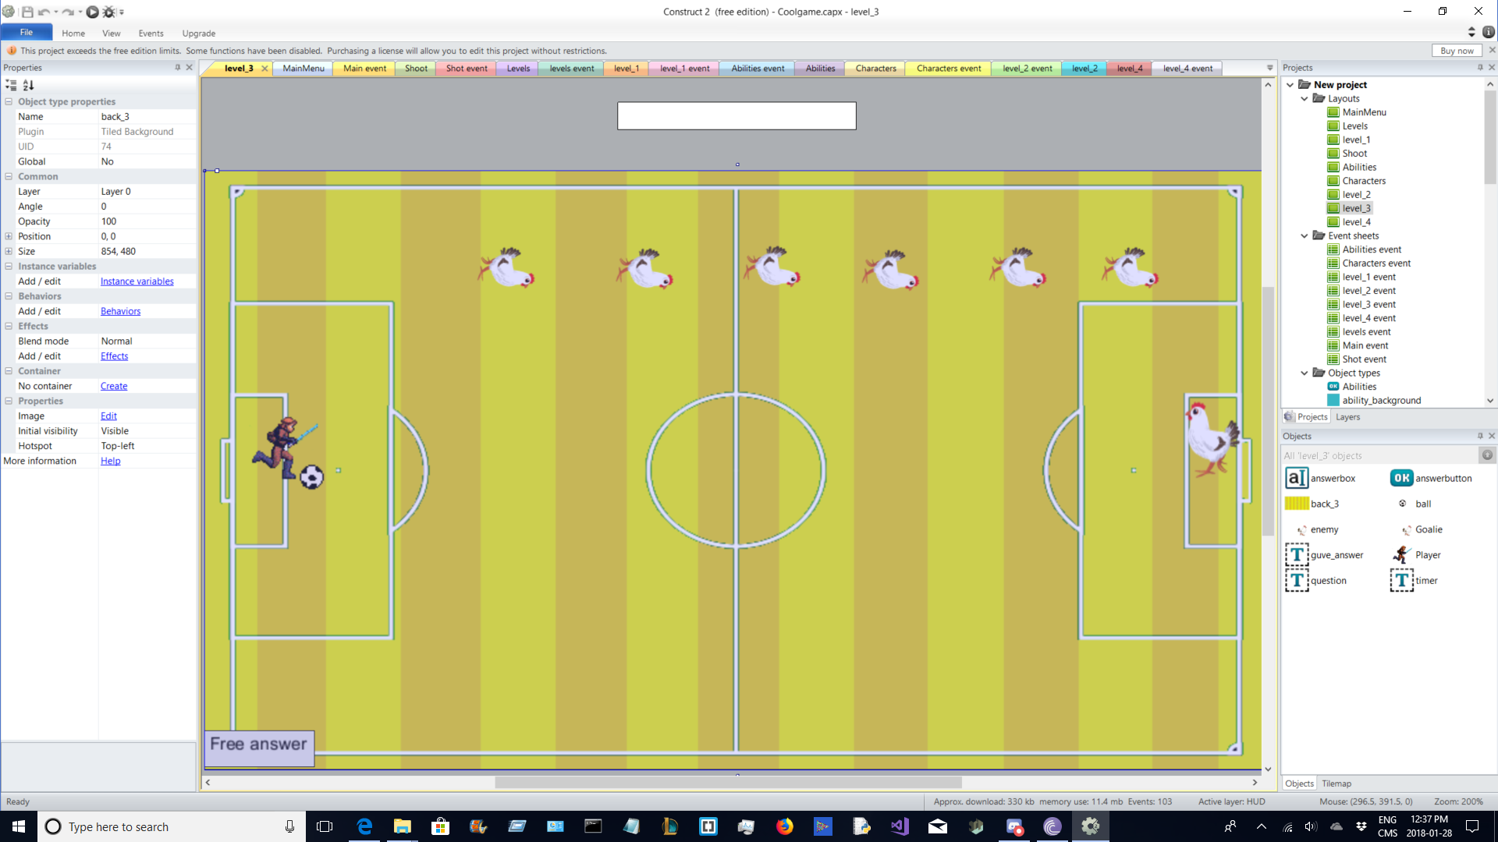
Dessert Field

Slide 27
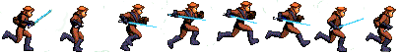
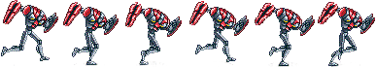
Characters
Anakin
Droid Bot
Obi Wan

Slide 28
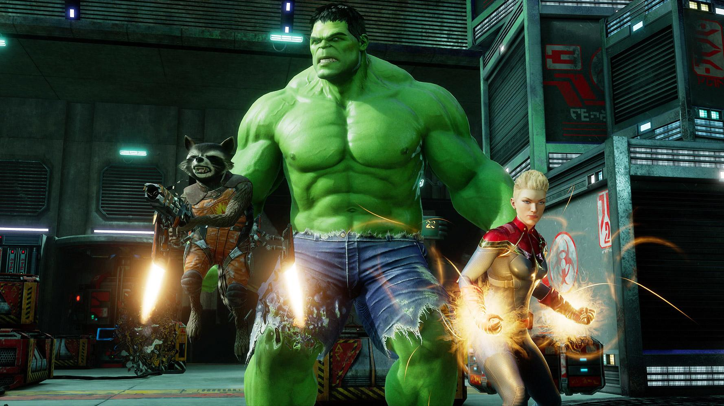

Abilities
One free answer
Extended time
Removal of some animals/enemies

Slide 29
Graphics/Sprites

Slide 30

Animals Requested
Dinosaur
Elephants
Monkey
Chickens
Cat/Doggo
Panda

Slide 31
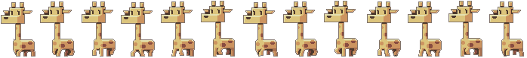
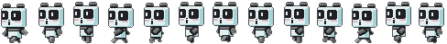
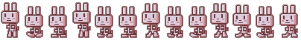
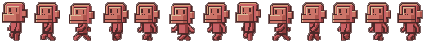




Slide 32

Where was it Located
Sprite Database
(http://spritedatabase.net/)

Slide 33

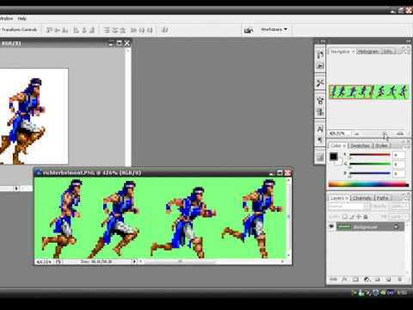
Photoshop to edit
Sprites

Slide 34
The Map: (Original)
Resolution 854, 480
(psd file can be found in google drive)

Slide 35

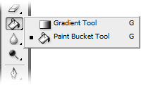
The rest were
edited using Construct 2

Slide 36
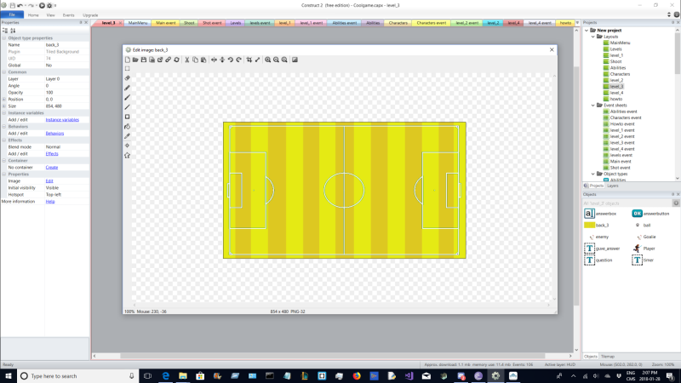
The Map: Desert

Slide 37
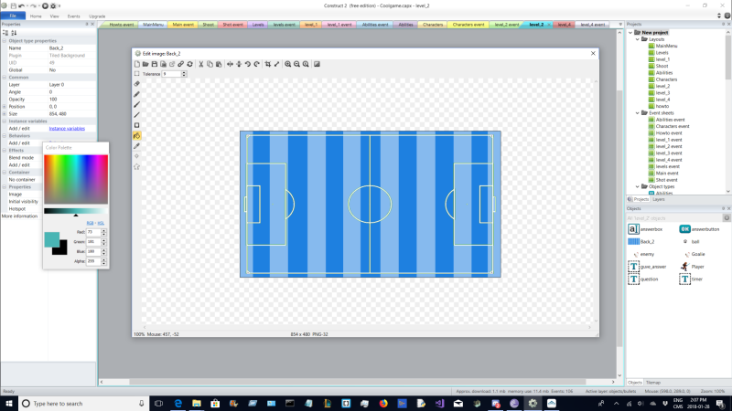
The Map: Under Water

Slide 38
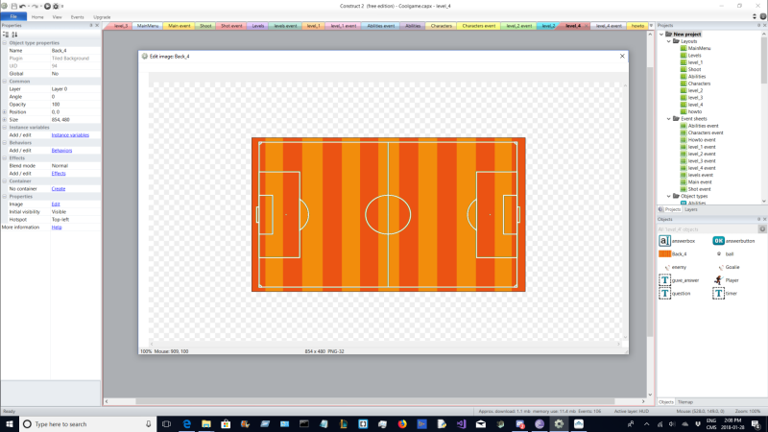
The Map: Volcano

Slide 39
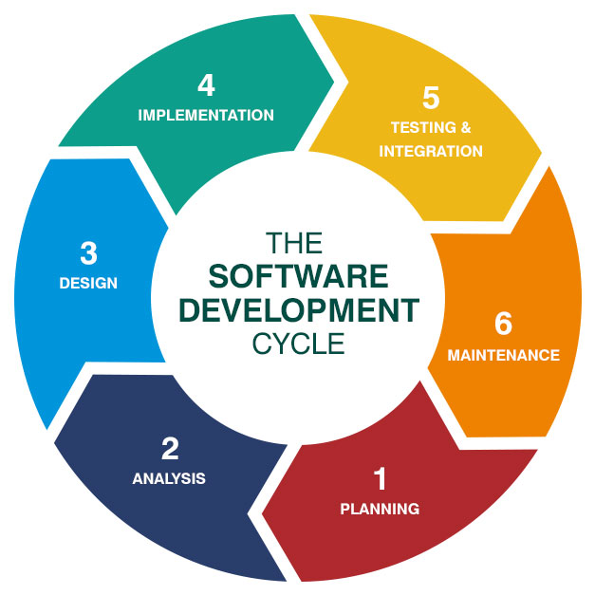
Game SDLC

Slide 40

Planning
Goal of game: To reach other side without getting hit by any animals/answering any questions wrong
Scoring goal by answering math question in end
Program used:

Slide 41
Pseudocode - Main Menu
Open menu screen
If levels button is clicked
go to levels page
If abilities button is clicked
go to abilities page
If How To Play is clicked
Go to how to play page
If characters button is clicked
Go to characters page

Slide 42
Pseudocode - Levels page
Load all 4 level objects
If “greenfield zone” is selected
Go to level_1 layout
If “Underwater zone” is selected
Go to level_2 layout
If “Desert zone” is selected
Go to level_3 layout
If ”Volcano zone” is selected
Go to level_4 layout

Slide 43
Pseudocode - Ability page
If “destroy” is selected
Delete all other checkmarks
Put a check mark
Set ability variable to 1
If “Extra time” is selected
Destroy all other checkmarks
Put a checkmark
Set ability variable to 2
If “Answer” is selected
Delete all other checkmarks
Put a check mark
Set ability variable to 3

Slide 44
Pseudocode - Characters page
If default is selected
Delete all other checkmarks
Put a checkmark
Set character variable to 0
If Obi-Wan is selected
Delete all other checkmarks
Put a checkmark
Set character variable to 1
If Assault Droid is selected
Delete all other checkmarks
Put a checkmark
Set character variable to 2

Slide 45
Pseudocode - level
Load field, enemies and player
If character = 0
Set animation to default
If character = 1
Set animation to Obi-Wan
If character = 2
Set animation to Assault droid
Create to random integers
Set answer variable to both integers added/subtracted together

Slide 46
Pseudocode - level
If player collides with enemy
Spawn text box with question
Spawn answer box
Start timer
If the player gets answer right
Destroy that enemy and move on
If the timer runs out
Restart the level
If the player collides with the goalie
Go to shoot layout

Slide 47
Pseudocode - Shoot
Spawn a text box with question
Spawn answer box
Start timer
If player gets the question right
Ball goes into the net
Go to main menu
Else
Ball misses the net
Restart level

Slide 48
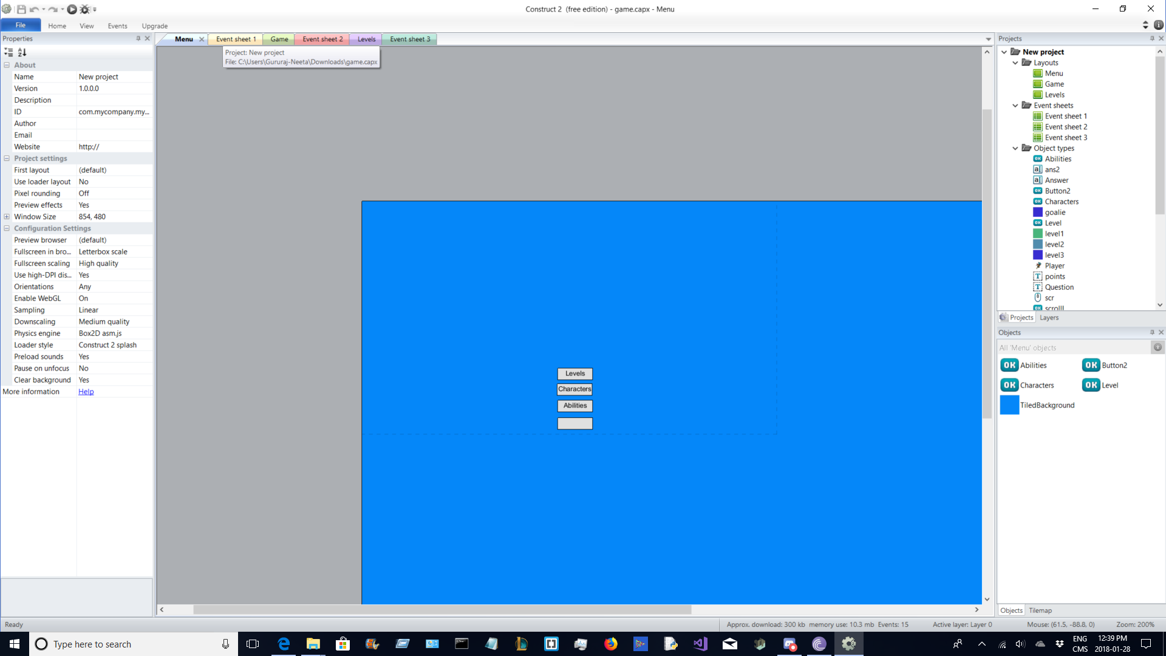
Prototype/Previous Versions

Slide 49
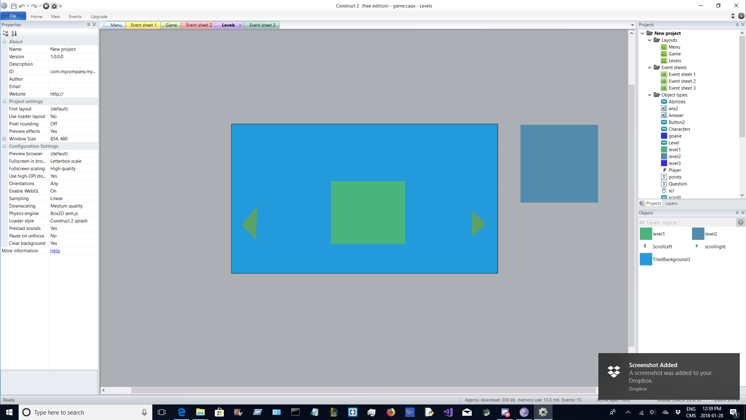

Slide 50
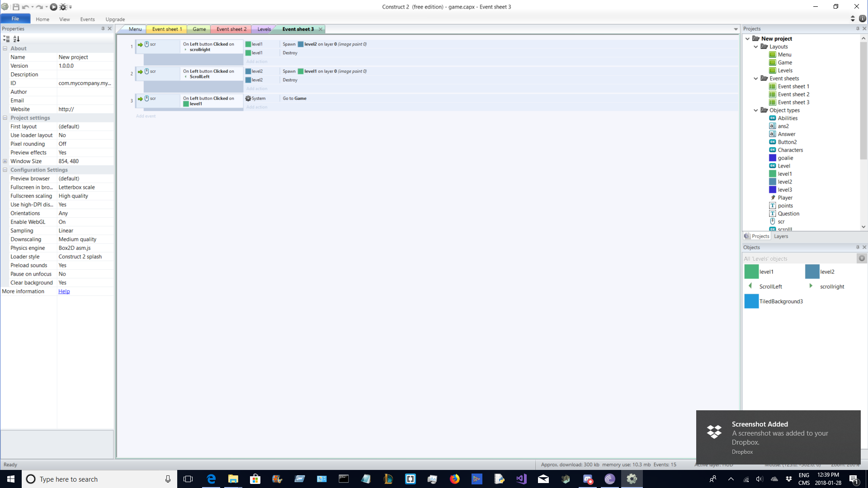

Slide 51
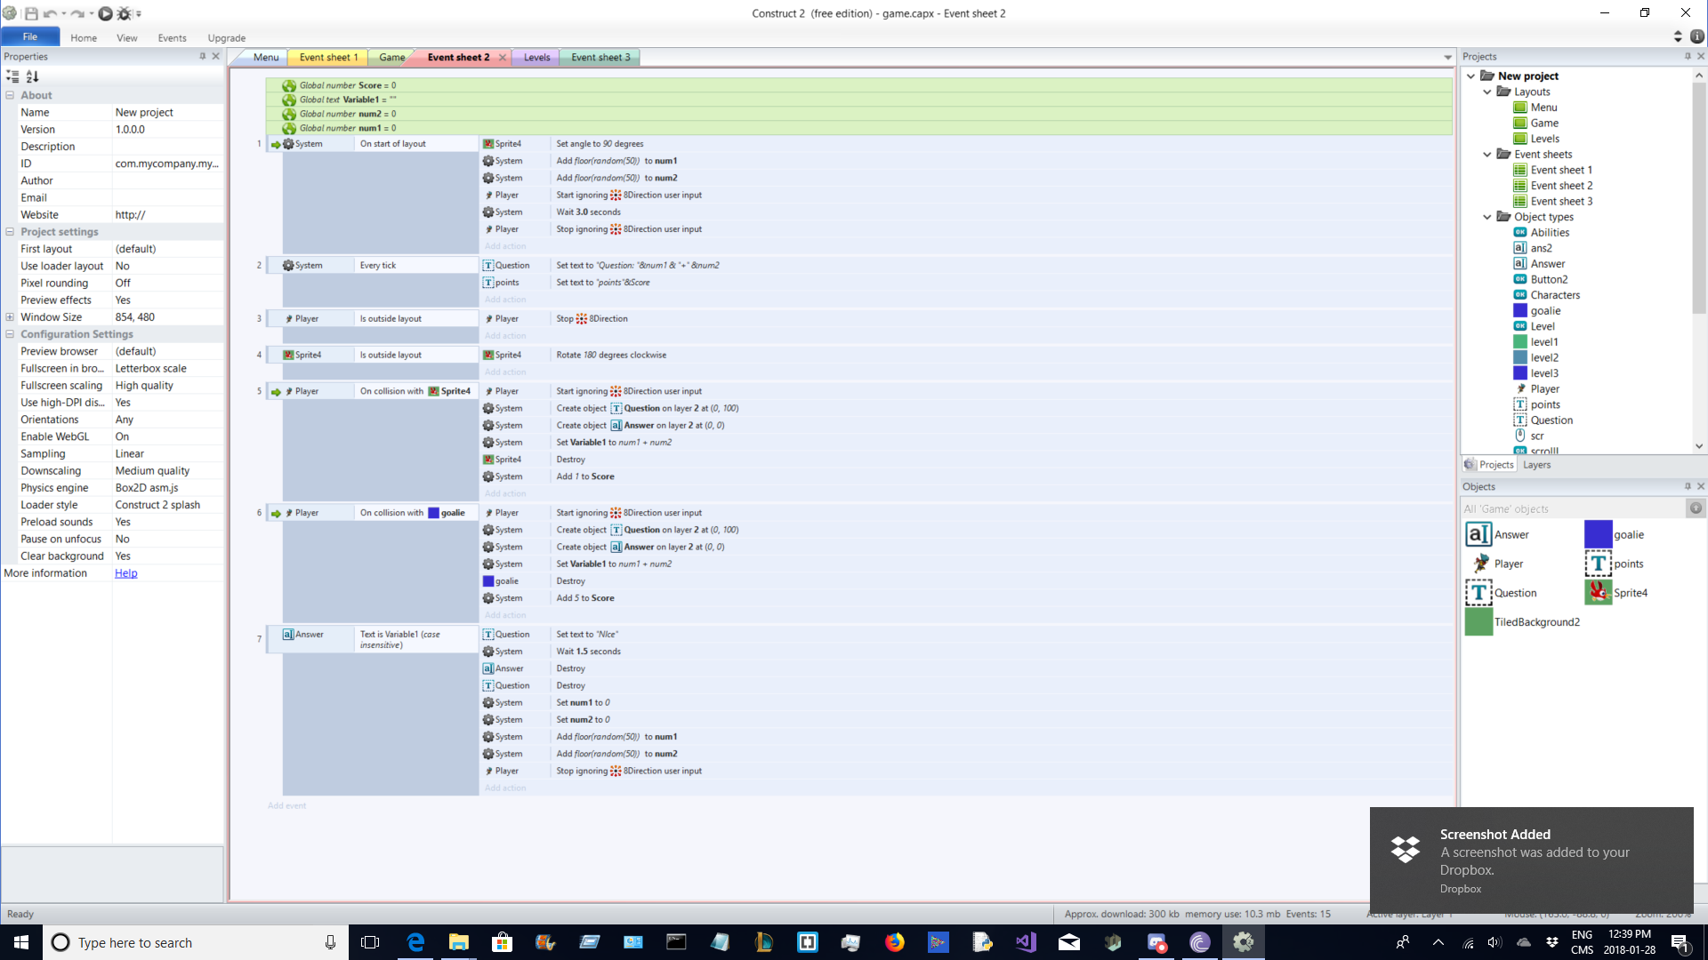

Slide 52
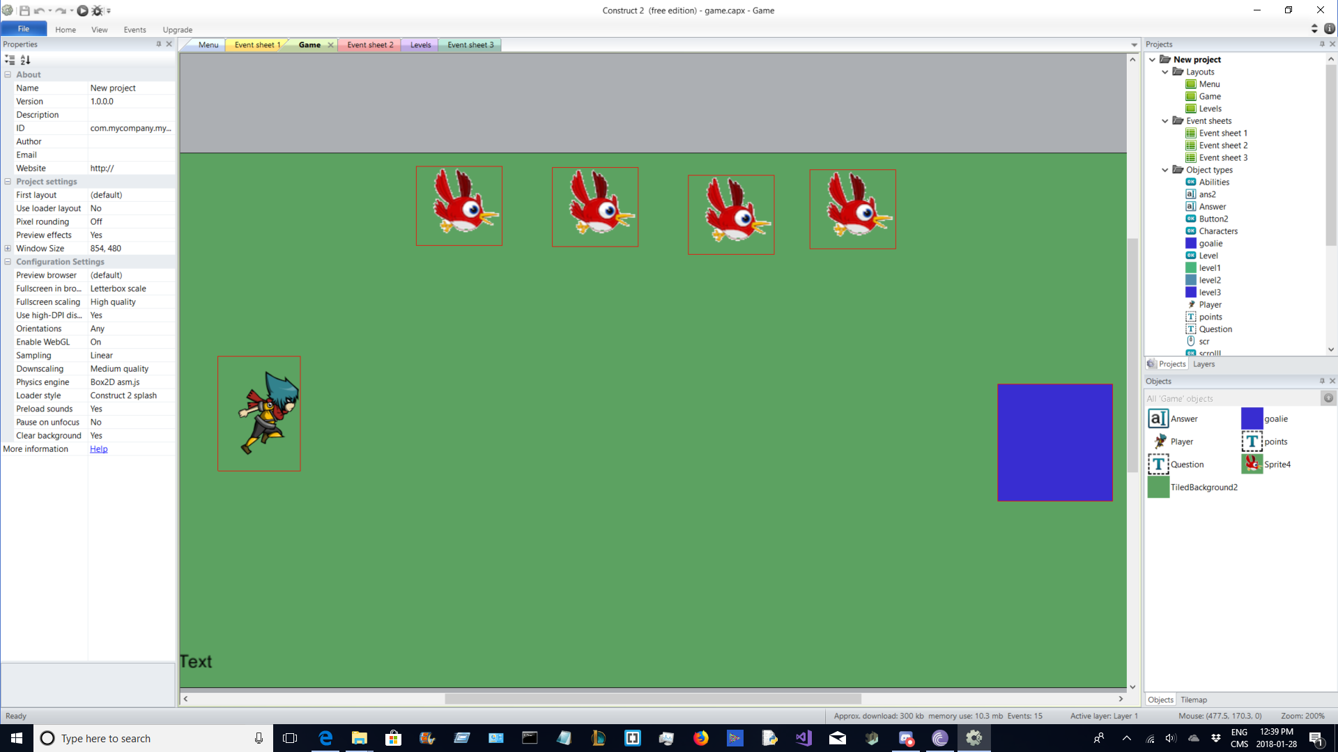

Slide 53

Defining/Analysis
2D
Cartoon Animals
Characters have set moving pattern
Basic Math questions
Addition, Subtraction, Multiplication

Slide 54
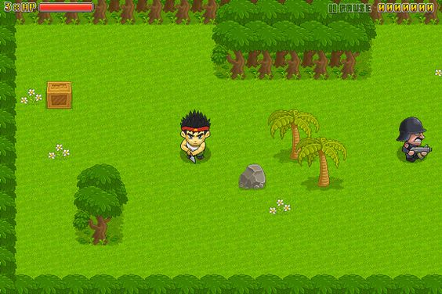
Design
Birds Eye view of the soccer field with the main character and animals, than when the character reaches the end, transfers to the first person view
Basic 2D
Resolution: 854x480 px

Slide 55
Development
Construct 2
Photoshop
Blender
To create an aesthetically pleasing and fun game for Salah, Xander and Tamara!

Slide 56
Testing
It was around the third visit where we had an actual playable game or prototype for the kids to play with, and we got some good feedback, unfortunately we were criticized by other groups kids, so we corrected some stuff and improved the game.

Slide 57
Improvements
Graphics
Removal of the lego aspect
Got rid of the box around the character
Got in way of the game
Came up with more difficult questions
Did most of the revision with the main titles

Slide 58
Deployment
We made major/minor changes after the third trip.
As we hand the kids the project, each of the kids will be able to test the game with whatever ability or map they want

Slide 59
Conclusion

Slide 60
Visits
Visit # 1:
Met and talked with our kids for the first time
Learned about their interests
Started game plan
Visit # 2:
Basic Game description finished
Presented kids with storyboard/interactive paper prototype
Received feedback and improvements
Asked kids to draw their characters, sprites and fields

Slide 61
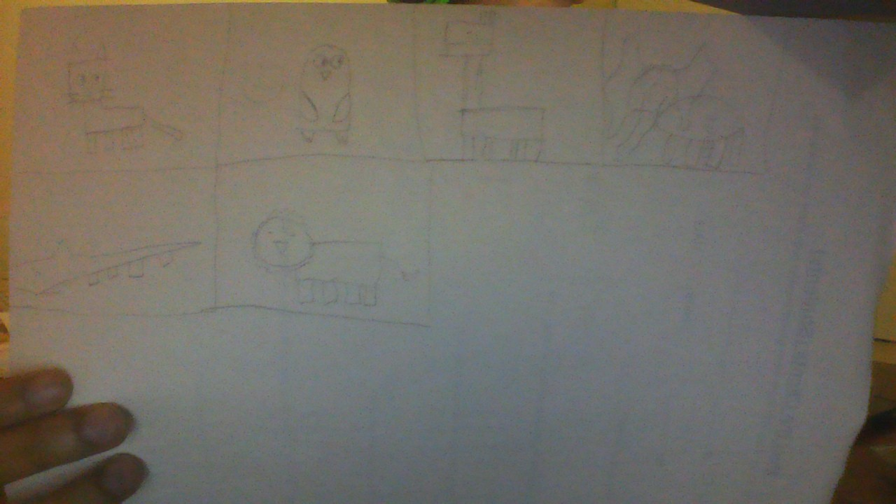

Slide 62
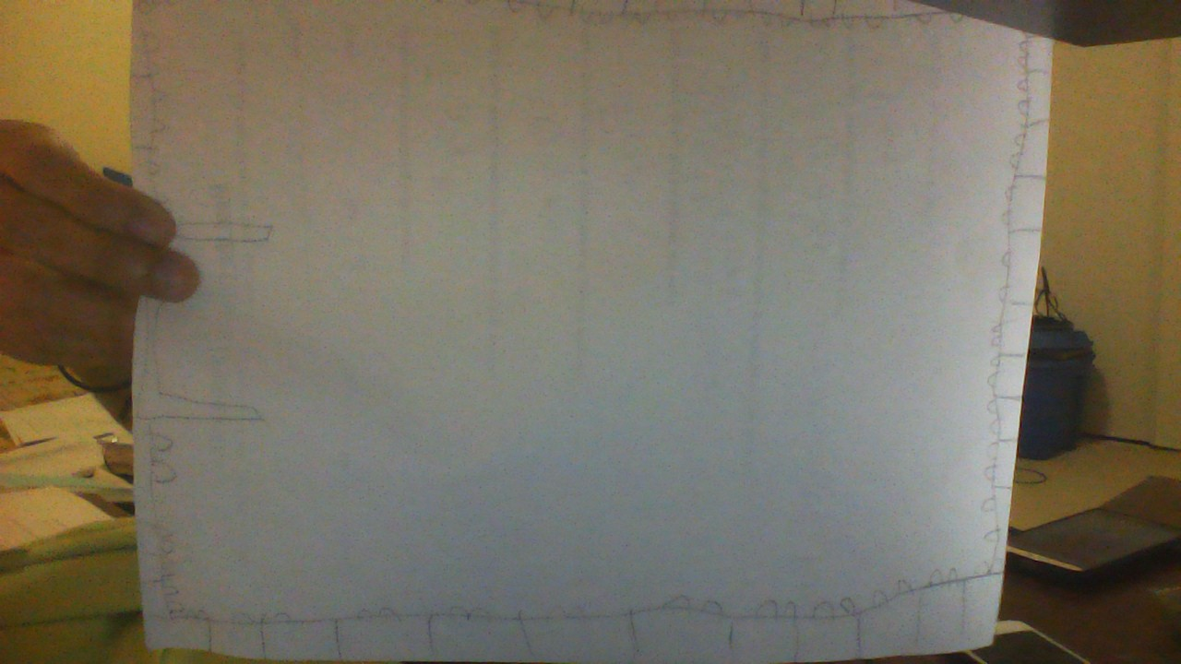

Slide 63
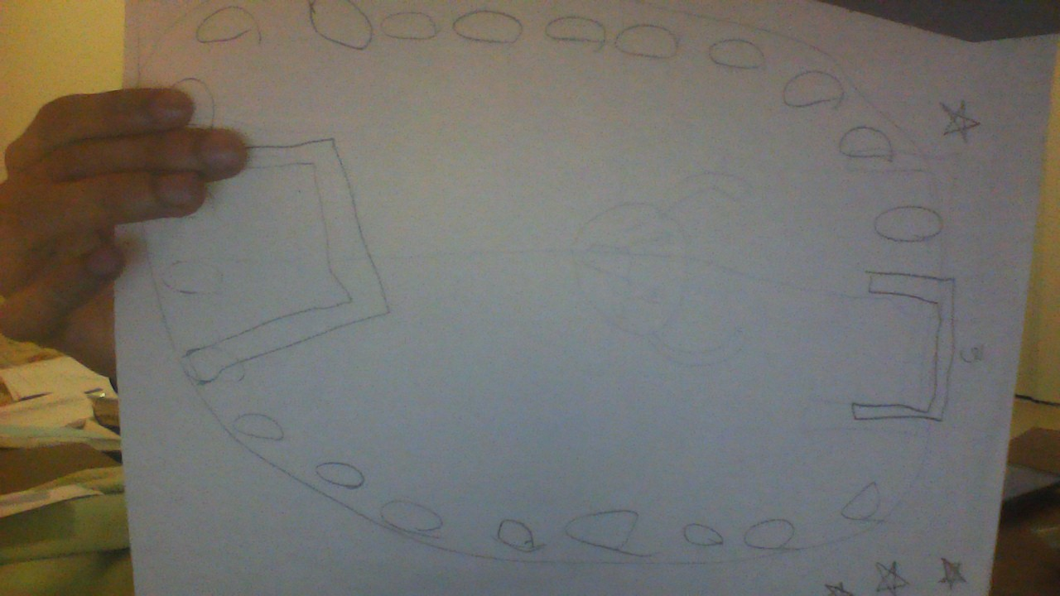

Slide 64
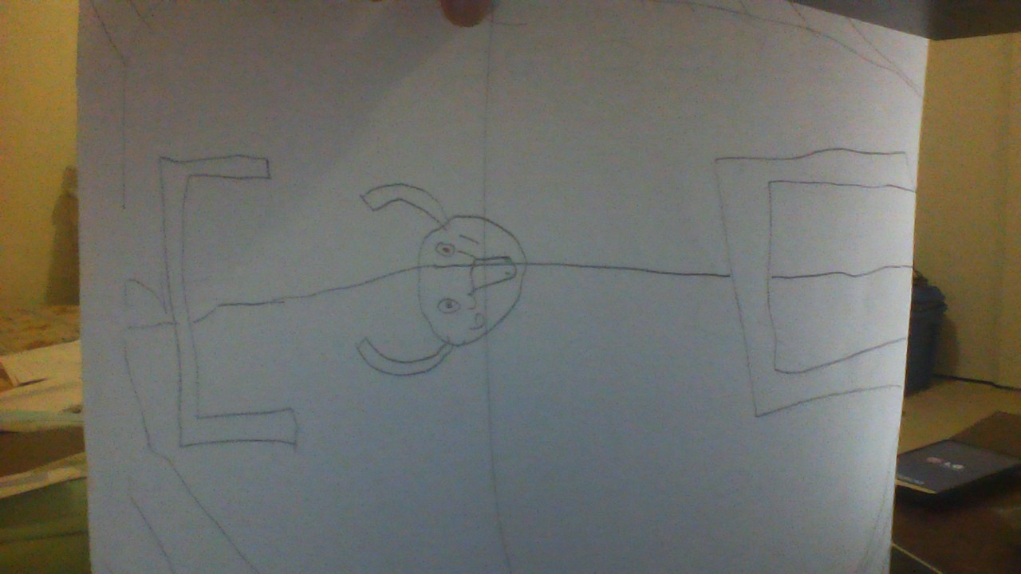

Slide 65
Visits
Visit # 3:
Presented the kids with a basic online working version of the game
Gave a rough idea on how the final product will look like
Received feedback for final product
Visit # 4:
Most of the game (85%) was now finished
The kids really had a good understanding on how the game was going to look like
Improvements → Final features

Slide 66
In the End...
We learned how to properly plan and develop a fully functional education-based game
Construct 2: Learned how to create a 2D game in this program
Blender: How to create a 3D opening game screen (creating grass, ball, flame and destroyed sphere)
Photoshop: How to use photoshop methods to improve sprites in construct 2

Slide 67
Individual Logs

Slide 68
Mandar: Game Design Head
Planning
Game Design
Game developpment
Prototypes
Worked with Construct 2
Made initial game
Helped Sundar with Documentation
Testing

Slide 69
Sundar: Documentation Head
Planning
Documentation → Google Slides
Prototype
Helped Mandar with Construct 2
Helped Rajessen with Graphics and game screen
Sprites → Photoshop
Testing

Slide 70
Rajessen: Graphics Head
Game Title → Blender
Sprites → Photoshop CC 2017
Terrains → Photoshop CC 2017
Characters → Photoshop CC 2017
(files for most of my work can can be found in google drive)
Helped Sundar with Documentation

Slide 71
Ben: Testing Head
Planning
Testing
Helped Mandar with game
Helped Sundar with Documentation
Helped Mandar Suggestions on improvements
Went over the logo with Raj

Slide 72

It Was A Good Learning Experience!

Slide 73
